Slide 1

CONCEPTS OF PROGRAMMING LANGUAGES
12th Edition
Chapter 16
Logic Programming
Languages

Slide 2
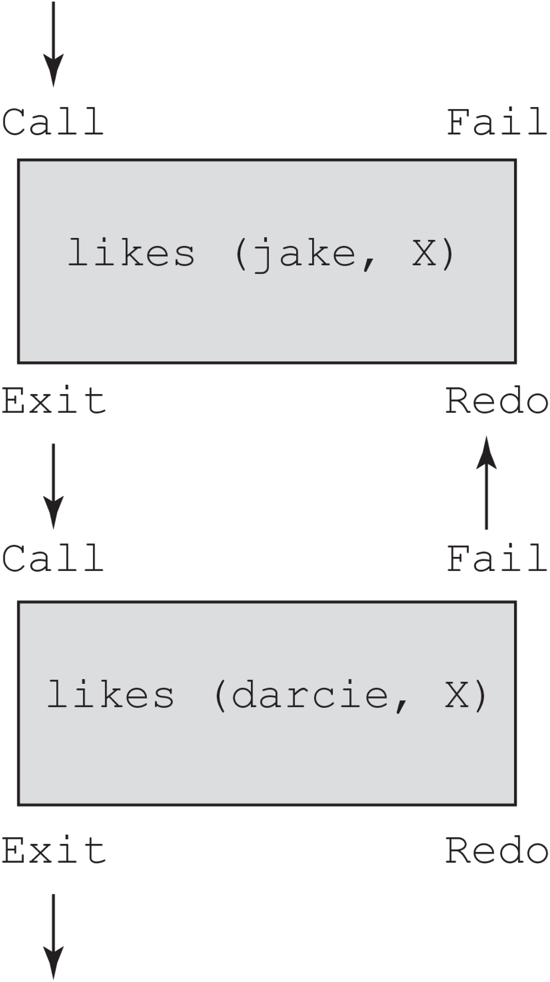
Figure 16-1 Control flow model for the goal likes (jake, X), likes (darcie, X)

